Slide 1
Simple Circuits Simulator
You build the following circuits using
DC Wiring Circuit Construction Simulator
http://phet.colorado.edu/sims/circuit-construction-kit/circuit-construction-kit-dc.jnlp

Slide 2
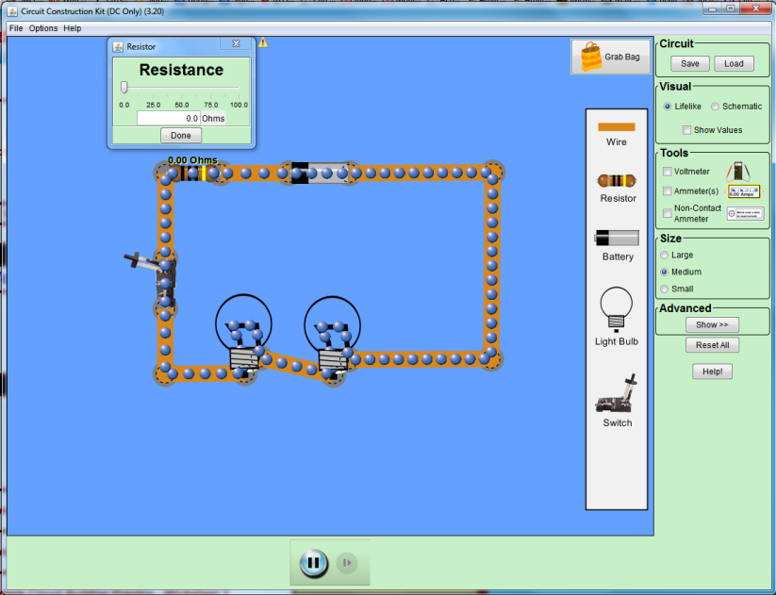
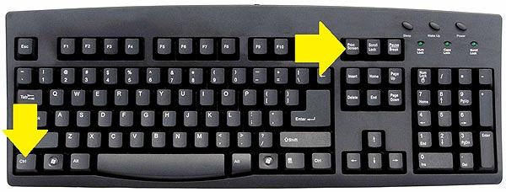
Copy each circuit after you build it in the simulator by pressing control-Print screen.

Slide 3

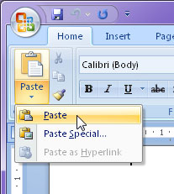
Then open Word and paste the circuit into a new document.

Slide 4
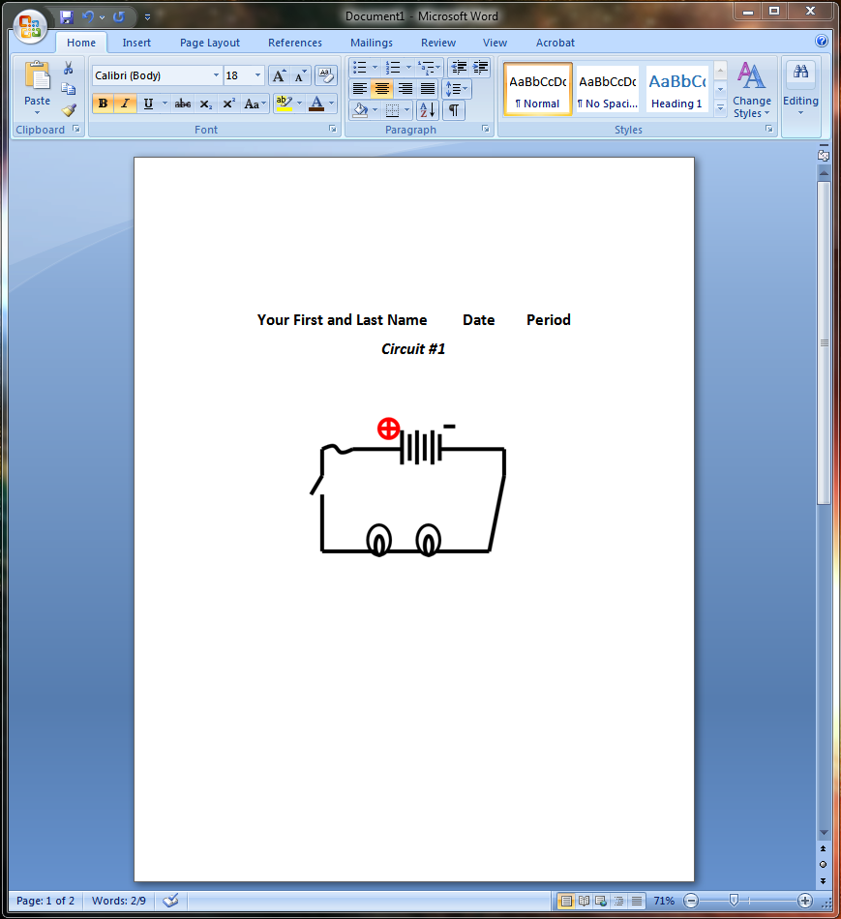
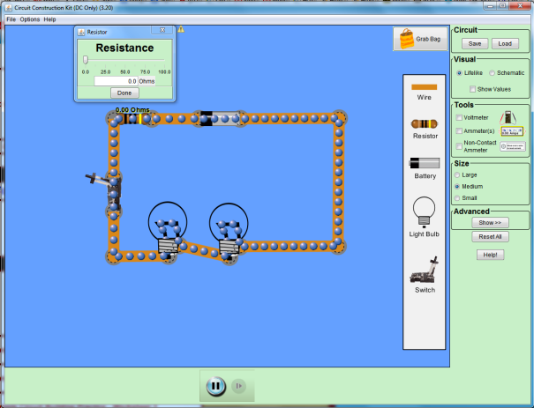
Add your name, date, period, and circuit number to the top of the page and print it.

Slide 5
Staple all six completed diagrams in order to the back of your task sheet and bring to your instructor for signature.

Slide 6
Simple Circuits l
Circuit #1
Simple series circuit w/ switch, 2 bulbs, power supply,
and fuse (use resistor with ohms set to zero)

Slide 7
Simple Circuits 2
Circuit #2
Simple parallel circuit w/ switch, 2 bulbs,
fuse (use resistor with ohms set to zero),
and power supply

Slide 8
Simple Circuits 3
Circuit #3
parallel circuit
Simple parallel circuit w/ switch, 2 bulbs,
fuse (use resistor with ohms set to zero),
and power supply

Slide 9
Simple Circuits 4
Circuit #4
parallel circuit
Simple parallel circuit w/ momentary contact switch, 2 bulbs,
fuse (use resistor with ohms set to zero), and power supply

Slide 10
Simple Circuits 5
Circuit #5
parallel circuit
Simple parallel circuit
w/ momentary contact switch, 4 bulbs,
fuse (use resistor with ohms set to zero),
and power supply

Slide 11
Simple Circuits 6
Circuit #6
parallel circuit
Simple parallel circuit w/ switch, 4 bulbs,
fuse (use resistor with ohms set to zero), and power supply

Slide 12
Staple all six completed diagrams in order to the back of your task sheet and bring to your instructor for signature.

